Slide 1
Covid Policy Tracker
Presenters:
1. Vaishali Wahi (s3808528)
2. Yanying Xu (s3691487)

Slide 2
Summary
The covid-19 policy tracker is a mobile friendly web app developed and hosted in the cloud platform that retrieves and presents real time data for covid cases and government policies in different countries.
The purpose is to track and analyze the level of restrictions in different countries to make users aware of the restrictions.
Tracks government policies from the early start of covid-19 till the present day.
Provides information on the number of confirmed cases, active cases and deaths.
Visualize the level of restrictions on different days/months and in different countries.
Provide information about the most affected areas through google maps.

Slide 3
Introduction
Covid-19 has claimed over 2.2 millions lives since late 2019.
Governments around the world have been responding to this pandemic and attempting to contain outbreaks.
Citizens can return to a relatively normal lives when their government has implemented policies successfully to contain the virus.
In case another pandemic occurs in future, we would be having the analysis of all the policies implemented in covid 19, which could help us in future with better risk mitigation plans.

Slide 4
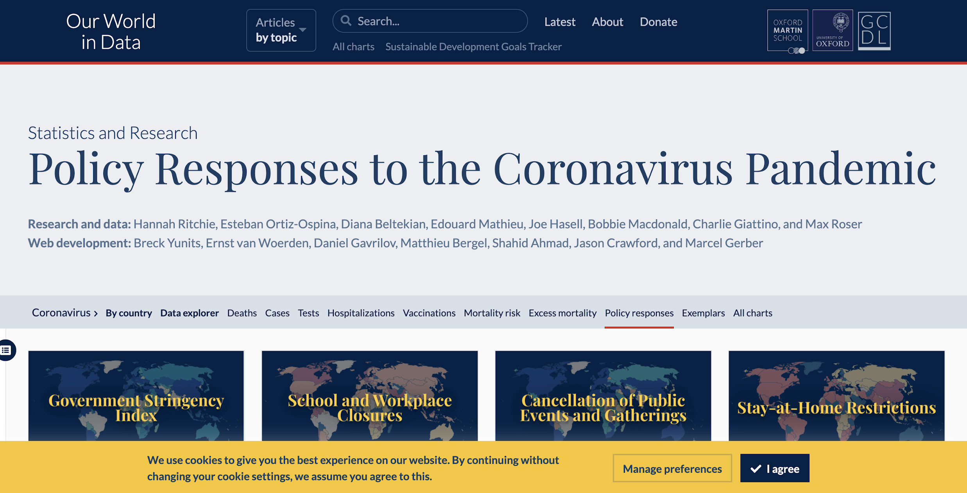
Related Work
We have done some research online, there is a research project that is using the same dataset named Policy Responses to the Coronavirus Pandemic on Our World in Data.

Slide 5
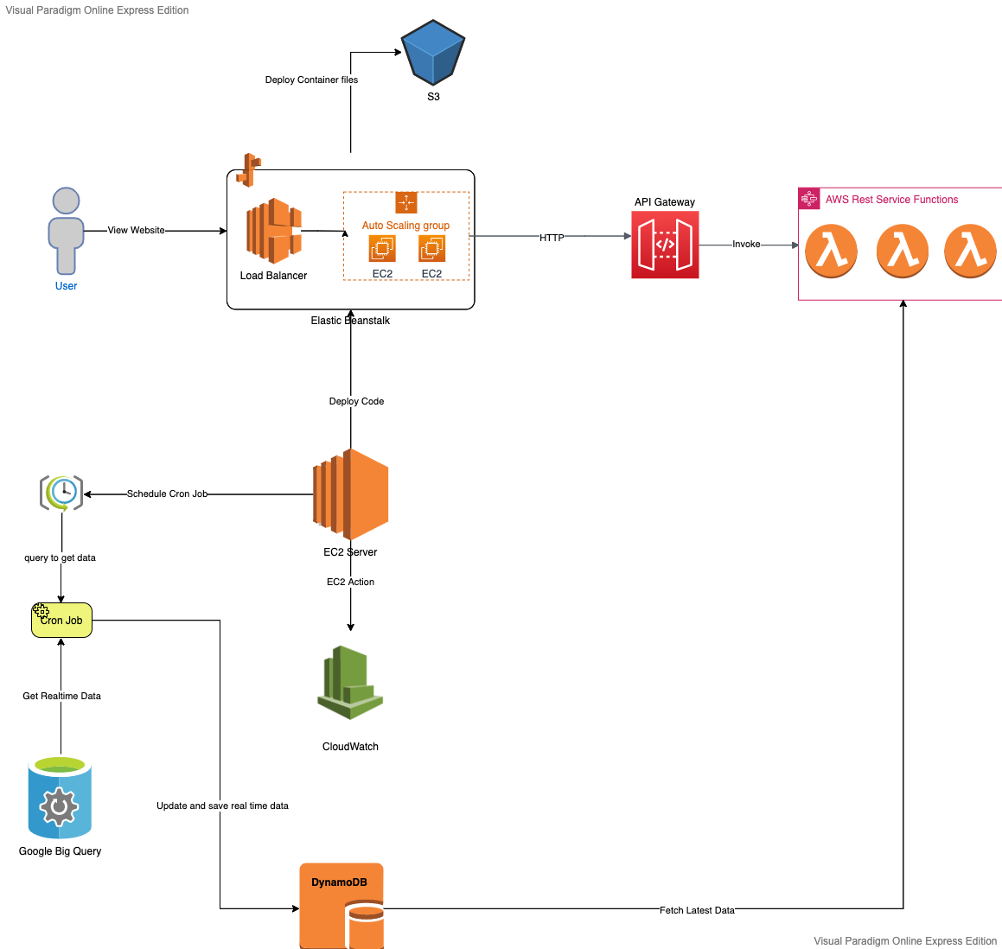
Architecture

Slide 6
Implementation
We implemented a web based application using flask web application. Our solution includes:
Mobile friendly web app
Hosted on cloud
Real time data

Slide 7








AWS/Google Cloud Services Used
Elastic Beanstalk | AWS Elastic Beanstalk is an orchestration service offered by Amazon Web Services for deploying applications which orchestrates various AWS services, including EC2, S3, Simple Notification Service, CloudWatch, autoscaling, and Elastic Load Balancers
S3 | Amazon S3 or Amazon Simple Storage Service is a service offered by Amazon Web Services that provides object storage through a web service interface
DynamoDB | Amazon DynamoDB is a fully managed proprietary NoSQL database service that supports key-value and document data structures.
API Gateway | It makes easy for developers to create, publish, maintain, monitor, and secure APIs at any scale.
Lamda | AWS Lambda is an event-driven, serverless computing platform
CloudWatch | It is a monitoring and management service that provides data and actionable insights for AWS, hybrid, and on-premises applications and infrastructure resources.
Cloud9 | It is an IDE provided by AWS to create,edit and update code just like any other editor.
Google Bigquery | BigQuery is an enterprise data warehouse that solves this problem by enabling super-fast SQL queries using the processing power of Google's infrastructure

Slide 8

Other Technologies Used
Flask/Python
Javascript
Jquery
HTML
CSS

Slide 9
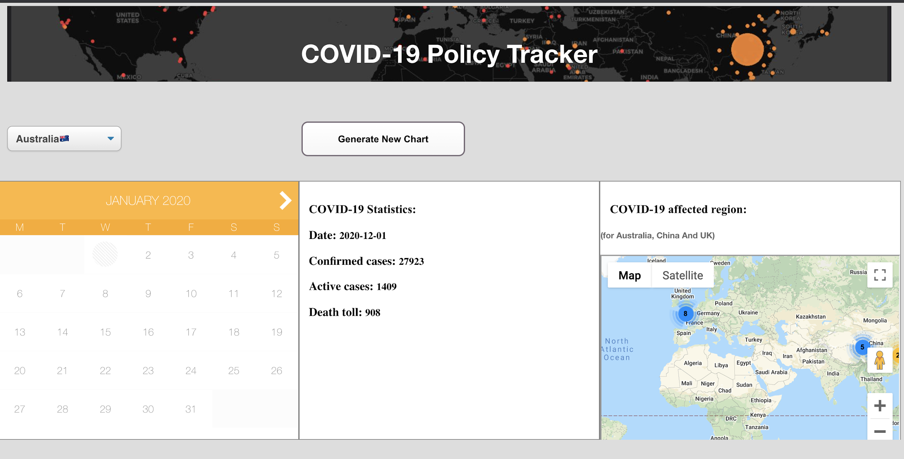
Our Solution Live Link

Slide 10
Future improvements
More dataset
More research on the data source
More data analysis
Better visualization
Breaking News section
Covid Policy Tracker version 1.0

